Slide 1

Glioma investigations using optical coherence tomography
Antonia Lichtenegger
OCT Paper Club 05.10.2020
antonia.lichtenegger@meduniwien.ac.at

Slide 2


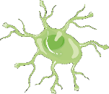
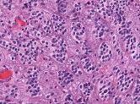
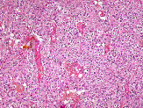
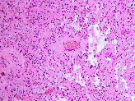
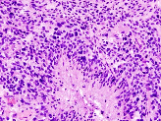
Brain Tumor:
Glioma
Glial cells
Ependymal cells
Oligodendrocytes
Astrocytes
Ependymomas
Astrocytomas
Glioblastoma
multiforme
Oligodendrogliomas
WHO Grade I-III
WHO Grade IV

Slide 3

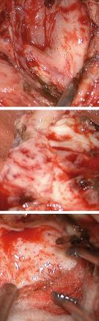
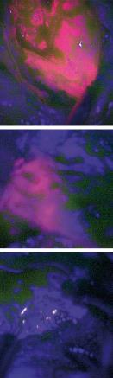
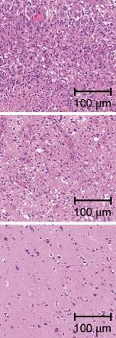
Glioblastoma
Only 2D information → improve maximal save resection by 3D information
Histology
Most aggressive primary brain tumor
Short survival time (median = 15 months)
Typical treatment involves surgery (maximal save resection) followed by radiotherapy and chemotherapy
5-ALA imaging: - Oral administration of 5-ALA fluorescence tracer - Tumor cells metabolize 5-ALA to PPIX - PPIX fluorescence red under blue light
Tumorous tissue
Infiltration zone
Brain parenchyma
[1] Widhalm G., PLOS ONE, 2013

Slide 4
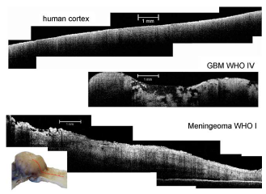
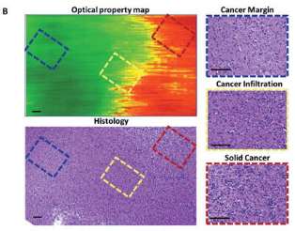
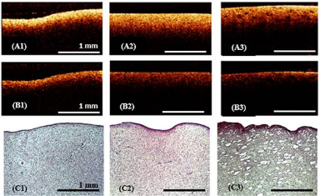
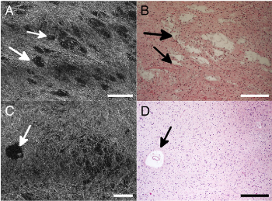
Optical coherence tomography for glioma investigations
Böhringer H.J., Imaging of human brain tumor tissue by near-infrared laser Coherence tomography, Acta. Neurochir., 2019
Kut C., Detection of human brain cancer infiltration ex vivo and in vivo using quantitative optical coherence tomography, Sci. Transl. Med., 2015
Yashin S.K. at al., Cross-Polarization Optical Coherence Tomography for Brain Tumor Imaging, Front. Oncol., 2019
Assayag O., Imaging of non-tumorous and tumorous human brain tissues with
full-field optical coherence tomography, NeuroImage, 2013

Slide 5
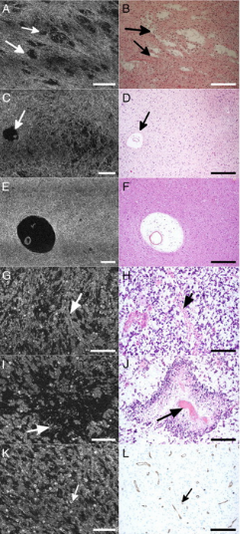
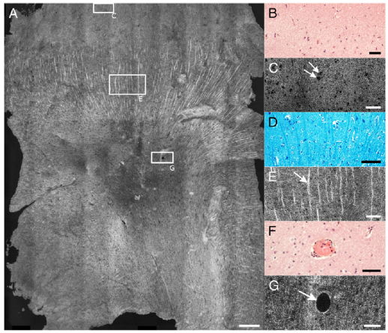
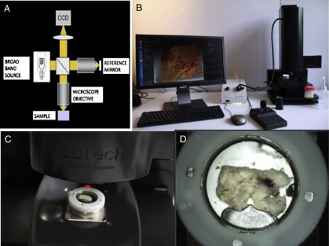
Assayag O., Imaging of non-tumorous and tumorous human brain tissues with
full-field optical coherence tomography, NeuroImage, 2013
50 μm
80 μm
Specifications: Light source: spatially incoherent (600-900 nm)
~ Δz = 1 μm
500 μm
50 μm
Cortex and white matter imaging
Glioma imaging

Slide 6
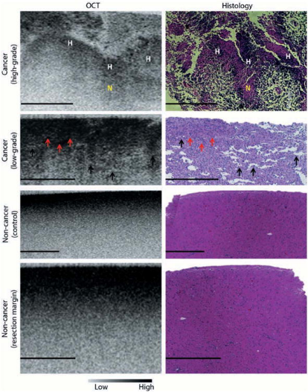
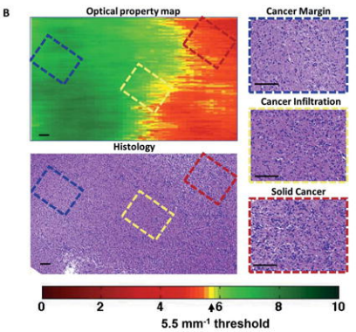
Kut C., Detection of human brain cancer infiltration ex vivo and in vivo using quantitative optical coherence tomography, Sci. Transl. Med., 2015
Specifications: FDML swept source: λ=1310 nm Δz = 6.4 μm and Δx = 16.0 μm
100 μm
500 μm
Attenuation evaluation
Ex-vivo human glioma tissue imaging
Notes:
Johns Hopkins University

Slide 7
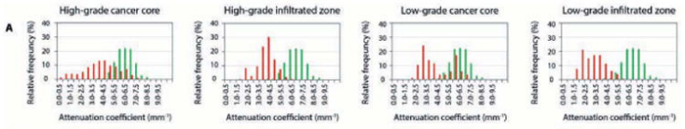
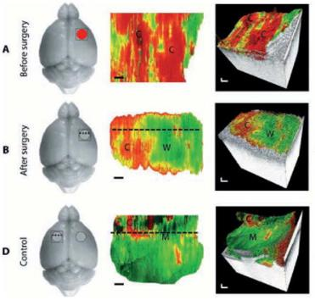
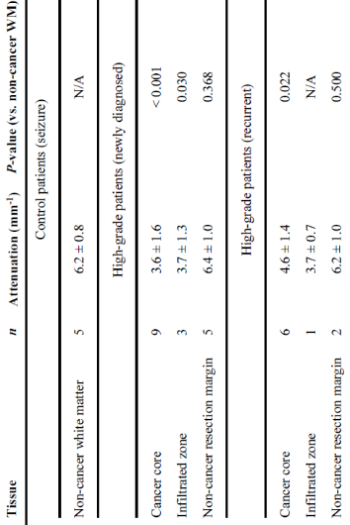
Kut C., Detection of human brain cancer infiltration ex vivo and in vivo using quantitative optical coherence tomography, Sci. Transl. Med., 2015
Cancer
Healthy
0.2 mm
In-vivo imaging of brain cancer in a mouse model

Slide 8
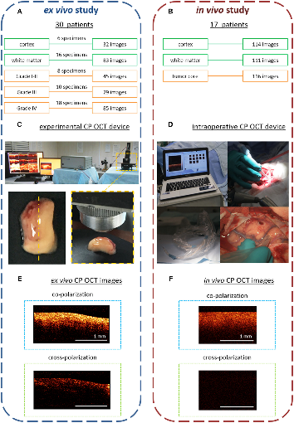
Yashin S.K. at al., Cross-Polarization Optical Coherence Tomography for Brain Tumor Imaging, Front. Oncol., 2019
Diffuse Astrocytoma Grade II
Diffuse Astrocytoma Grade II
Diffuse Astrocytoma Grade III
White matter
Glioblastoma
Co- and cross polarization
Histology
Polarization | Sensitivity % | Specificity % | Diagnostic accuracy
Co- | 89-93 | 67-73 | 83-84
Cross- | 80-87 | 75-89 | 82-83
Both | 82-85 | 92-94 | 87-88
Specifications: Light source: λ= 1300 nm Δz = 10 μm and Δx = 15 μm

Slide 9
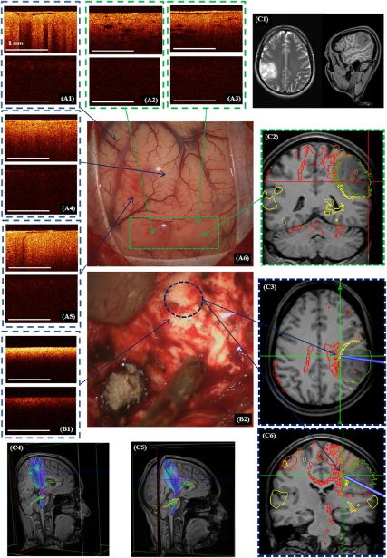
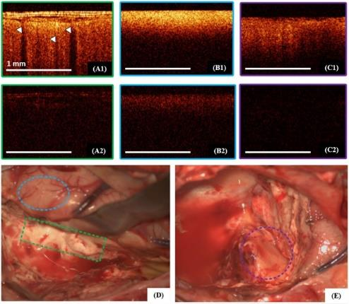
Yashin S.K. at al., Cross-Polarization Optical Coherence Tomography for Brain Tumor Imaging, Front. Oncol., 2019
Cortex
White matter
Astrocytoma
Intraoperative Co- and cross polarization OCT

Slide 10
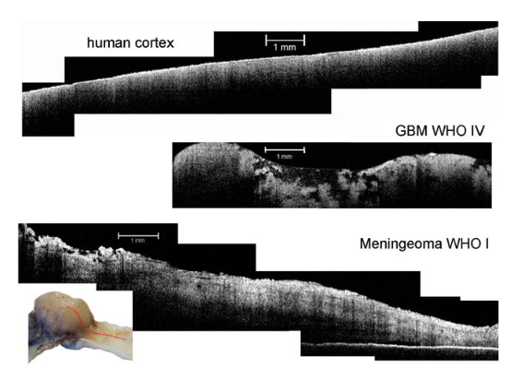
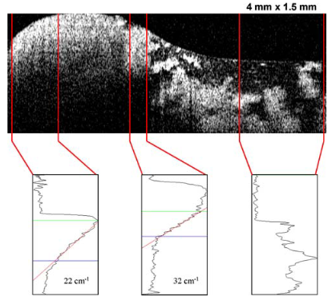
Böhringer H.J., Imaging of human brain tumor tissue by near-infrared laser coherence tomography, Acta. Neurochir., 2019
Specifications: Light source: SLD, λ= 1300 nm Δz = 15 μm and Δx = 15 μm
Calculation of scattercoeffient along A-lines
Notes:
Hüttmann Group

Slide 11
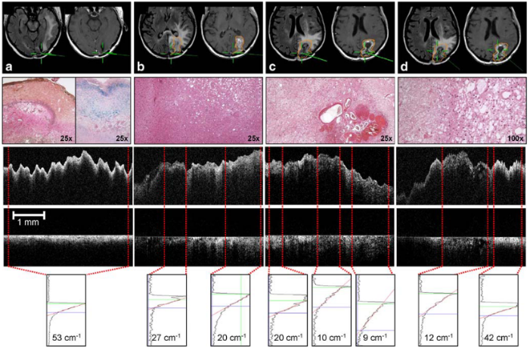
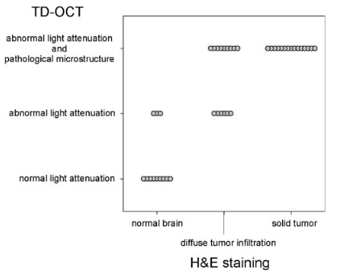
Böhringer H.J., Imaging of human brain tumor tissue by near-infrared laser coherence tomography, Acta. Neurochir., 2019
Collagen-rich cortical scar
High cellular tumor region
Tumor core and necrosis
Infiltration zone
Investigator scored the OCT and the H&E images
Notes:
Hüttmann Group

Slide 12
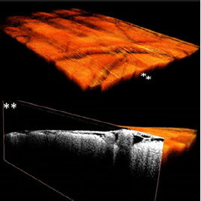
Future for optical coherence tomography for glioma investigations
Use OCT in combination with feature extraction to distinguish healthy from cancerous tissue
Integrate multiple contrast channels, for example combine 5-ALA and OCT imaging
Use real time assistance to help the surgeon during the operation (additional contrast mechanisms and deep learning)
Almasian M., Pilot feasibility study of in vivo intraoperative quantitative optical coherence tomography of human brain tissue during glioma resection, Journal of Biophotonics, 2019

Slide 13
Thank you for your attenuation!

